Slide 1
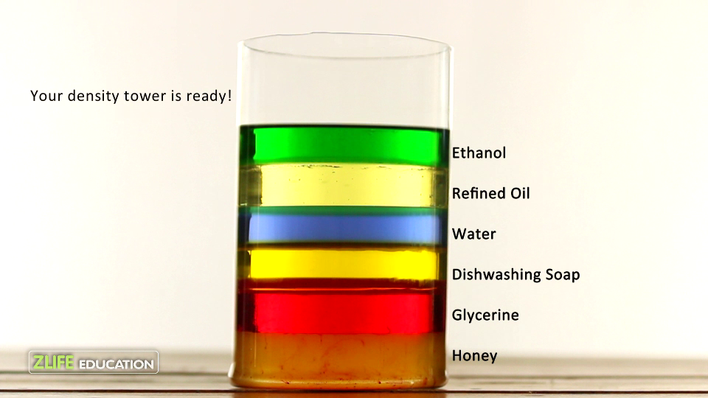
Density
Measuring Liquids

Slide 2
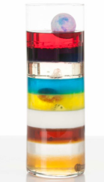
Liquids Have Density
http://www.youtube.com/watch?v=-CDkJuo_LYs
Liquids with different densities form layers
  The liquid with the highest density
  will be on the bottom.
  The liquid with the lowest density
  will be on the top.
Solid objects can float or sink
in liquids with different densities

Slide 3
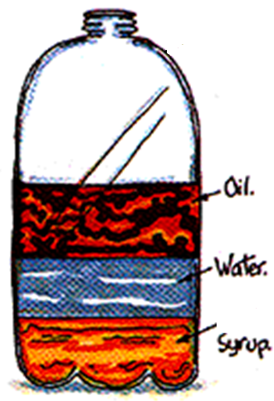
Liquid Layers
Lowest density
Which liquid has the highest density?
Which liquid has the lowest density?
Which liquid has the middle density?
Highest density

Slide 4
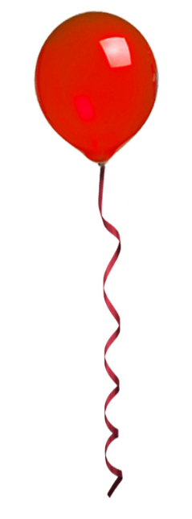
Gasses Also Have Density
Gasses with different densities also form layers
  Since gases are invisible it is sometimes hard to see.
  Helium balloons float because helium is less dense than air
Wind and weather are the result of air density
  Hot air is less dense than cold air
  Rising hot air causes wind and rain

Slide 5
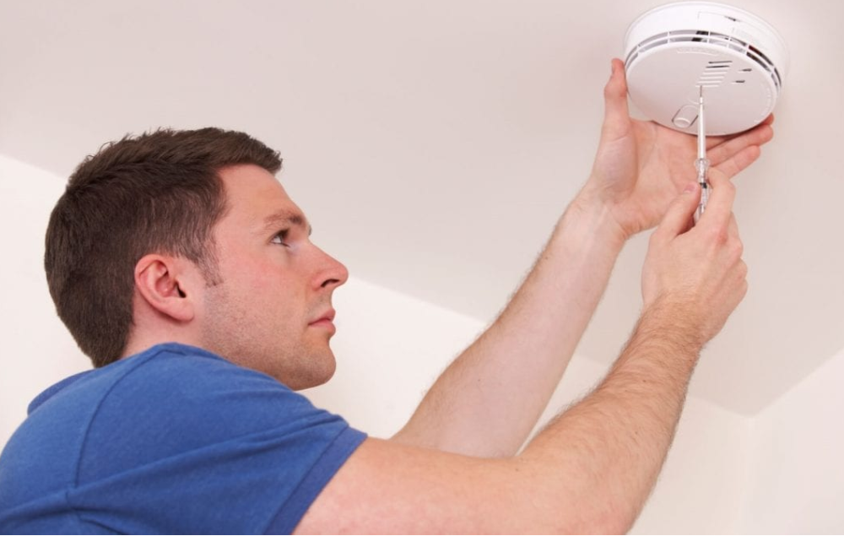
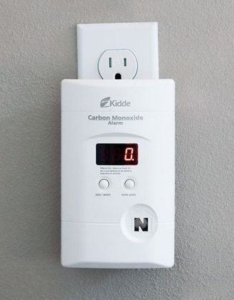
Density & Home Safety
Smoke detectors should be placed on the ceiling
  Smoke particles are less
  dense than air.
Carbon Monoxide detectors should be placed on the wall
  Carbon Monoxide (CO) is the same density as air.
  Carbon Monoxide is a poisonous gas produced by malfunctioning furnaces and idling cars.

Slide 6
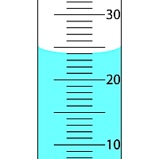
Measuring Volume using a
Graduated Cylinder
The surface of a liquid in a Graduated Cylinder is not flat
  Surface tension causes the liquid
  to be higher at the sides
This rounded shape is called
a meniscus.
We measure the volume at the
bottom of the meniscus
  This volume is: 24 ml

Slide 7
Measuring Volume using a
Graduated Cylinder
The surface of a liquid in a Graduated Cylinder is not flat
  Surface tension causes the liquid
  to be higher at the sides
This rounded shape is called
a meniscus.
We measure the volume at the
bottom of the meniscus
  This volume is: 24 ml

Slide 8
Measuring Volume using a
Graduated Cylinder
The surface of a liquid in a Graduated Cylinder is not flat
  Surface tension causes the liquid
  to be higher at the sides
This rounded shape is called
a meniscus.
We measure the volume at the
bottom of the meniscus
  This volume is: 24 ml
24 ml

Slide 9
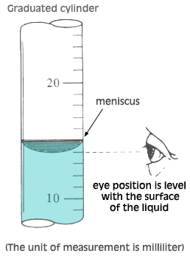
Measuring Volume using a
Graduated Cylinder
You must bend over to read
the markings on the graduated cylinder.
  The graduated cylinder must be on a flat desk
  Your eye must be at the same
  level as the meniscus
You must NEVER pick up
the graduated cylinder to bring it up to your eye.

Slide 10
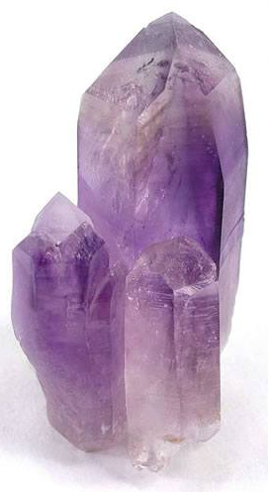
Measuring the Volume of an
Irregular Solid
How can we measure the volume of an irregular shape?
  There are no sides to easily measure
  There is no formula to calculate
  (e.g. L x W x H)
We can use the water displacement method
  If the solid object sinks then the water level will rise by the same volume as the object.

Slide 11
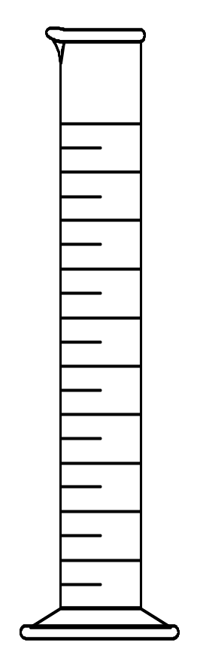
Volume Displacement
A solid displaces a matching volume of water when placed in water.
33 mL
25 mL

Slide 12
Volume Calculation
Calculate the volume of water displaced by the object
  The volume of water before the object is placed in the graduated cylinder is 25 ml.
  The volume of water before the object is placed in the graduated cylinder is 33 ml.
1) 25 ml 2) 33 ml 3) 8 ml
33 mL
25 mL
33 ml
- 25 ml
= 8 ml

Slide 13
Learning Check
What is the density of 48 g of a metal if the metal raises the level of water in a graduated cylinder from 25 mL to 33 mL?
1) 0.2 g/ cm³ 2) 6 g/m³ 3) 252 g/cm³
33 mL
25 mL
G → m=48g
v=8ml
R→ d=?
A→ d=m/v
=48g/8ml
S→ =6g/ml
S→ the density is 6g/ml

Slide 15
Review
What is the formula for density?
What happens if you pour together liquids that have different densities?
Will the liquid on the top have the highest or lowest density?

Slide 16
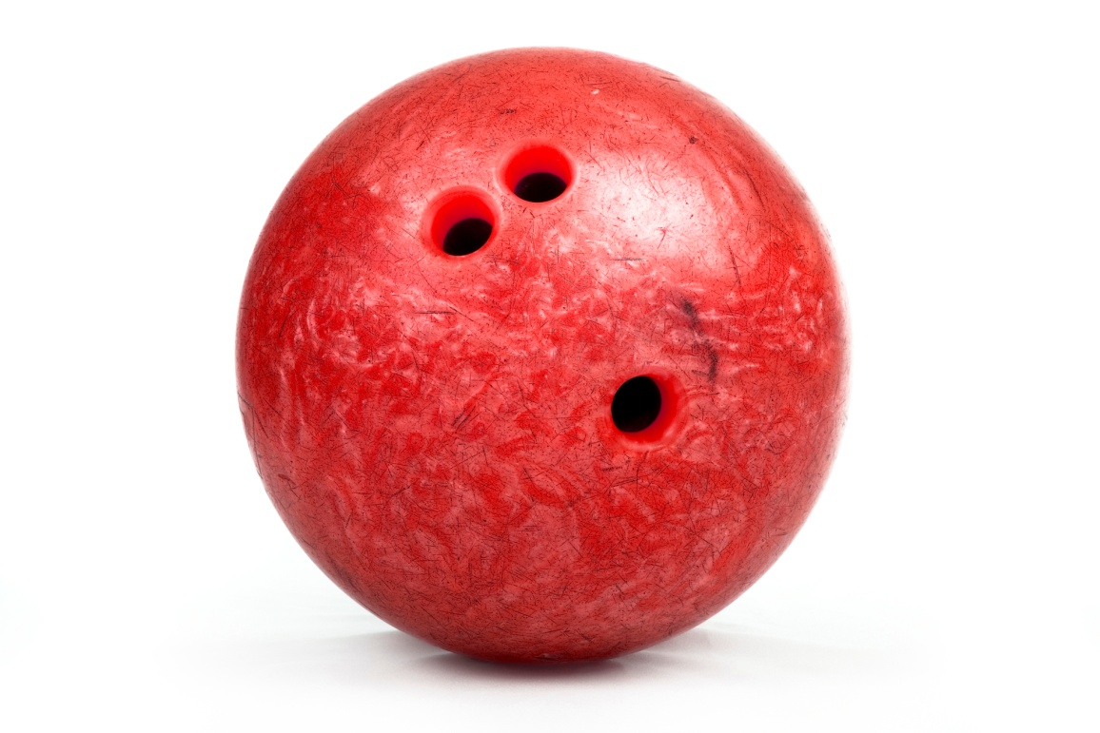
What would happen????
If you put a bowling ball in water?
http://www.youtube.com/watch?v=Lwc6QklQGFw
Notes:
Sinking vial - make it float

Slide 17
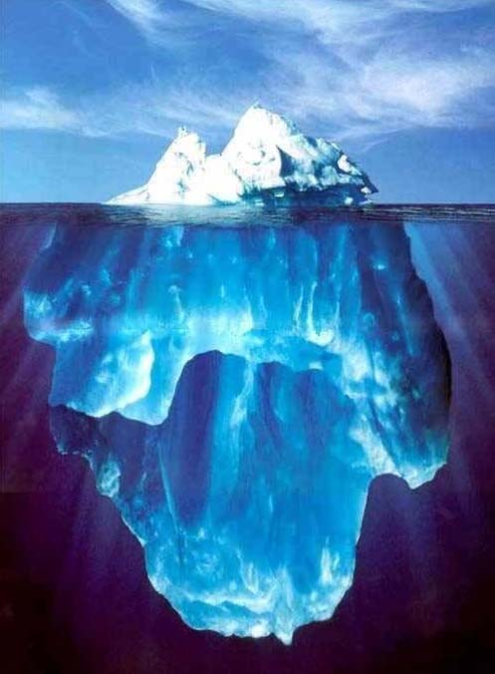
SOLIDS
Why does ice float in water?
  Because Ice is less dense than water
Notes:
Beans/ping pong ball; Big jug of water in a pool

Slide 18
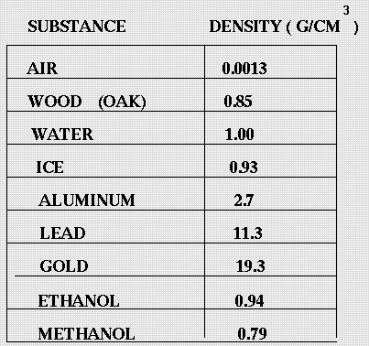
SINK or FLOAT In Water
Lower densities will float, higher will sink
Float
Float
Float
Sink
Sink
Sink
(alcohol)
Float
(fuel)
Float

Slide 19
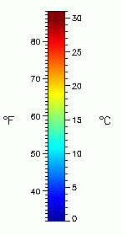
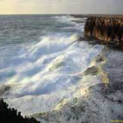
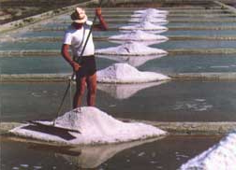
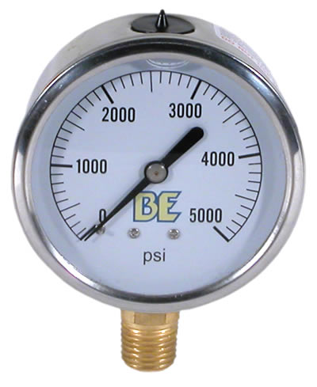
Factors affecting Density
Temperature
Pressure
Dissolved solids – in liquids
    Ex salt in water
Notes:
Add several drops of red food color to each of two 250-mL Erlenmeyer flasks; fill them with warm tap water. (If tap water is not warm, heat some tap water on a hot plate to 40-45 °C.)
Add several drops of blue food coloring to each of the other two 250-mL Erlenmeyer flasks; fill them with cool tap water.
Predict the outcome when one flask is inverted over the other.
Place a paper card on top of the vessel filled with warm water. Invert the flask making sure to hold the card in place. Stack it on top of one of the cool water flasks. Remove the card. Remain prepared to catch the flasks.
** Visual here.
Place a paper card on top of the flask filled with cool water. Invert the flask making sure to hold the card in place. Stack it on top of the other warm water flask. Remove the card.
** Visual here.
Wide mouth containers may also be used.

